Slide 1
Music Recommendation System
Team members:
Tejal
Aamir Khan
Alpana
Swapnil
Prasad
Yugandhara
Shiva
Mentor:
Neha

Slide 2
Why Music Recommendation?
The music provider can predict and then offer the appropriate songs to their users based on the characteristics of the music that has been heard previously.
The main objective of our music recommendation system is to provide suggestions to the users that fit the user's preferences.

Slide 3
Importance of music recommendation system
A music recommender solution is essentially a solution that allows music streaming platforms to offer their users relevant music recommendations in real-time.
It provides personalization and thus boosts user engagement.
Automative curating playlisting audio.
Make your platform maximum personalized.
Get insights about users behavior and make data based marketing decisions.
Provide quality and immersive customer streaming experience.

Slide 4
How its works:
#Data Analysis:
>The system collects data from various sources
Such as music streaming platforms , social media,
User preferences.
#Algorithm:
>Using sophisticated machine learning techniques,the
Algorithums learn about the users preferences and suggest
Similar music.
#Application:
>The system integrats with music streming
Applications like Spotify or apple muaic and recommends
Personalized playlists to the users.

Slide 5
Project WorkFlow:
Understanding the objectives.
Importing the necessary libraries.
Loading the Dataset.
Data understanding.
Data preprocessing.
Exploratory Data analysis.
Feature Scaling.
Data visualization.
Model building using user based collaborative filtering.
Model training and testing.
Model Deployment.

Slide 6
Data Collection and Analysis:
User listening Habits:
>Analysing user listening helps deternine musical
Preferences,favorite genres,and frequently played
Artists.
Social Media Trends:
>By monitoring social media plaforms,the system captures
Emerging trends and identifies popular songs,artists and
Genres.
Artists Information:
>Collecting data about individual artists, their styles ,
Collaborations,and attributes helps in creating meaningful
Recommendations.

Slide 7
Data collection and Analysis:
1.Data collection.
2.Pre-processing.
3.Analysis.
4.Feature Extraction.

Slide 8
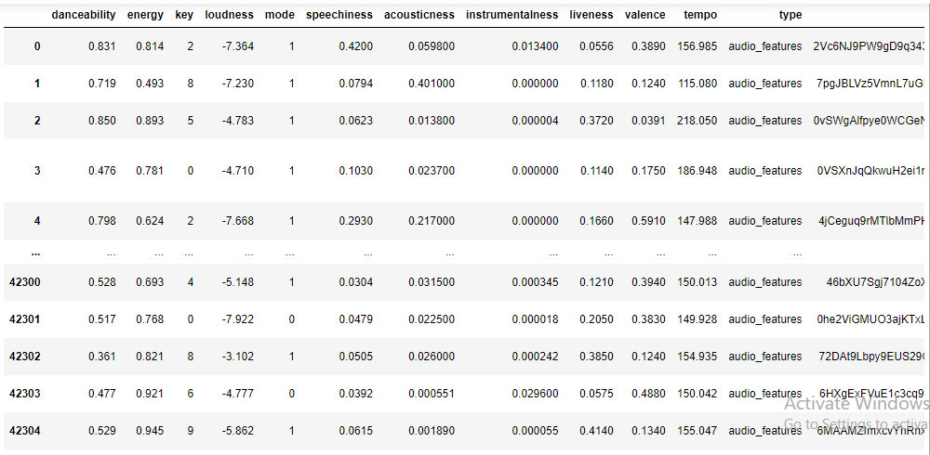
After understanding the objective of the project and then importing all the necessary libraries, we will import the required dataset in csv format. Our dataset consist of 42305 rows and 20 columns in total.
 | danceability | energy | key | loudness | mode | speechiness | acousticness | instrumentalness | liveness | valence | tempo | type | id | uri | track_href | analysis_url | duration_ms | time_signature | genre | song_name
0 | 0.831 | 0.814 | 2 | -7.364 | 1 | 0.4200 | 0.059800 | 0.013400 | 0.0556 | 0.3890 | 156.985 | audio_features | 2Vc6NJ9PW9gD9q343XFRKx | spotify:track:2Vc6NJ9PW9gD9q343XFRKx | https://api.spotify.com/v1/tracks/2Vc6NJ9PW9gD... | https://api.spotify.com/v1/audio-analysis/2Vc6... | 124539 | 4 | Dark Trap | Mercury: Retrograde
1 | 0.719 | 0.493 | 8 | -7.230 | 1 | 0.0794 | 0.401000 | 0.000000 | 0.1180 | 0.1240 | 115.080 | audio_features | 7pgJBLVz5VmnL7uGHmRj6p | spotify:track:7pgJBLVz5VmnL7uGHmRj6p | https://api.spotify.com/v1/tracks/7pgJBLVz5Vmn... | https://api.spotify.com/v1/audio-analysis/7pgJ... | 224427 | 4 | Dark Trap | Pathology
2 | 0.850 | 0.893 | 5 | -4.783 | 1 | 0.0623 | 0.013800 | 0.000004 | 0.3720 | 0.0391 | 218.050 | audio_features | 0vSWgAlfpye0WCGeNmuNhy | spotify:track:0vSWgAlfpye0WCGeNmuNhy | https://api.spotify.com/v1/tracks/0vSWgAlfpye0... | https://api.spotify.com/v1/audio-analysis/0vSW... | 98821 | 4 | Dark Trap | Symbiote
3 | 0.476 | 0.781 | 0 | -4.710 | 1 | 0.1030 | 0.023700 | 0.000000 | 0.1140 | 0.1750 | 186.948 | audio_features | 0VSXnJqQkwuH2ei1nOQ1nu | spotify:track:0VSXnJqQkwuH2ei1nOQ1nu | https://api.spotify.com/v1/tracks/0VSXnJqQkwuH... | https://api.spotify.com/v1/audio-analysis/0VSX... | 123661 | 3 | Dark Trap | ProductOfDrugs (Prod. The Virus and Antidote)
4 | 0.798 | 0.624 | 2 | -7.668 | 1 | 0.2930 | 0.217000 | 0.000000 | 0.1660 | 0.5910 | 147.988 | audio_features | 4jCeguq9rMTlbMmPHuO7S3 | spotify:track:4jCeguq9rMTlbMmPHuO7S3 | https://api.spotify.com/v1/tracks/4jCeguq9rMTl... | https://api.spotify.com/v1/audio-analysis/4jCe... | 123298 | 4 | Dark Trap | Venom
... | ... | ... | ... | ... | ... | ... | ... | ... | ... | ... | ... | ... | ... | ... | ... | ... | ... | ... | ... | ...
42300 | 0.528 | 0.693 | 4 | -5.148 | 1 | 0.0304 | 0.031500 | 0.000345 | 0.1210 | 0.3940 | 150.013 | audio_features | 46bXU7Sgj7104ZoXxzz9tM | spotify:track:46bXU7Sgj7104ZoXxzz9tM | https://api.spotify.com/v1/tracks/46bXU7Sgj710... | https://api.spotify.com/v1/audio-analysis/46bX... | 269208 | 4 | hardstyle | NaN
42301 | 0.517 | 0.768 | 0 | -7.922 | 0 | 0.0479 | 0.022500 | 0.000018 | 0.2050 | 0.3830 | 149.928 | audio_features | 0he2ViGMUO3ajKTxLOfWVT | spotify:track:0he2ViGMUO3ajKTxLOfWVT | https://api.spotify.com/v1/tracks/0he2ViGMUO3a... | https://api.spotify.com/v1/audio-analysis/0he2... | 210112 | 4 | hardstyle | NaN
42302 | 0.361 | 0.821 | 8 | -3.102 | 1 | 0.0505 | 0.026000 | 0.000242 | 0.3850 | 0.1240 | 154.935 | audio_features | 72DAt9Lbpy9EUS29OzQLob | spotify:track:72DAt9Lbpy9EUS29OzQLob | https://api.spotify.com/v1/tracks/72DAt9Lbpy9E... | https://api.spotify.com/v1/audio-analysis/72DA... | 234823 | 4 | hardstyle | NaN
42303 | 0.477 | 0.921 | 6 | -4.777 | 0 | 0.0392 | 0.000551 | 0.029600 | 0.0575 | 0.4880 | 150.042 | audio_features | 6HXgExFVuE1c3cq9QjFCcU | spotify:track:6HXgExFVuE1c3cq9QjFCcU | https://api.spotify.com/v1/tracks/6HXgExFVuE1c... | https://api.spotify.com/v1/audio-analysis/6HXg... | 323200 | 4 | hardstyle | NaN
42304 | 0.529 | 0.945 | 9 | -5.862 | 1 | 0.0615 | 0.001890 | 0.000055 | 0.4140 | 0.1340 | 155.047 | audio_features | 6MAAMZImxcvYhRnxDLTufD | spotify:track:6MAAMZImxcvYhRnxDLTufD | https://api.spotify.com/v1/tracks/6MAAMZImxcvY... | https://api.spotify.com/v1/audio-analysis/6MAA... | 162161 | 4 | hardstyle | NaN

Slide 9
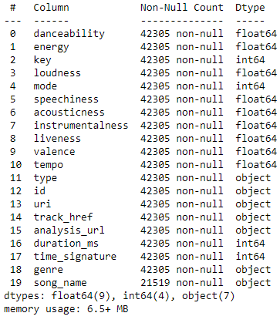
Data Understanding:
Columns/Feature of our data:
>Columns,energy,key,loudness,specchiness,acoustiness,
Instrumentalness,liveness,valence,tempo,id,genre,song name.
Data Type:

Slide 10
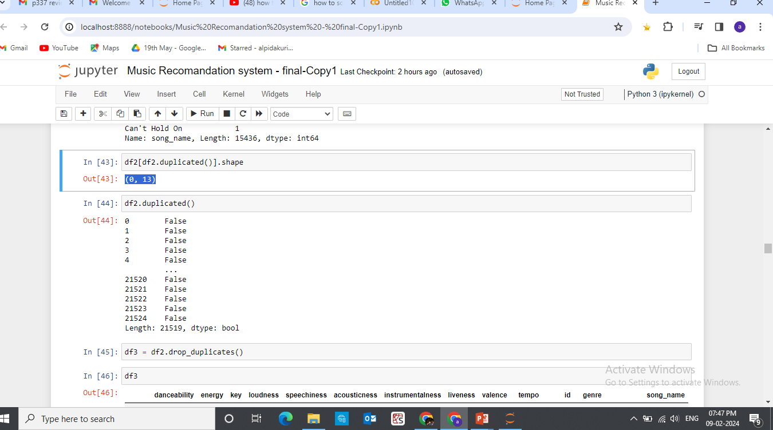
After removing all the three duplicates datapoints:
(0,13)
After removing all the duplicates values:
Number of unique users:
18352
Shape of the data:

Slide 11
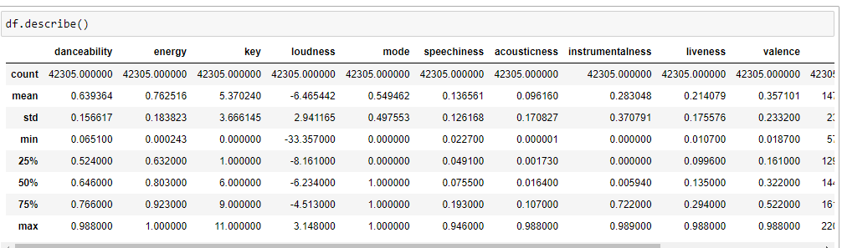
Describing the data set:
Data set information:

Slide 12
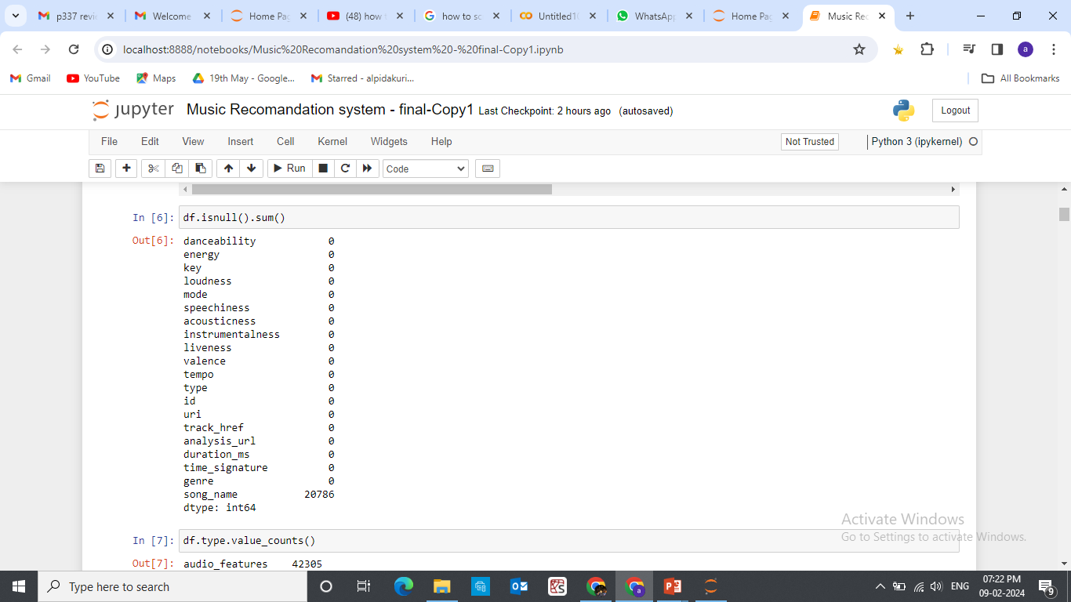
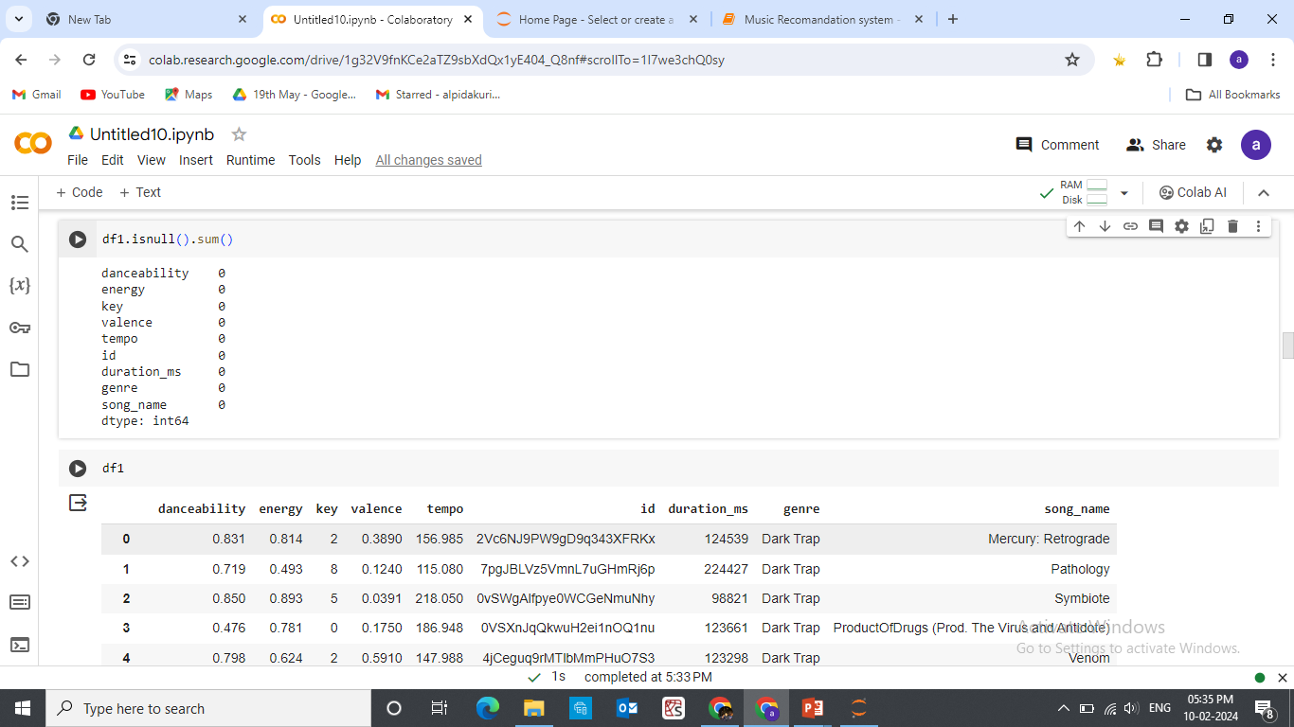
Exploratory Data Analysis(EDA):
Finding out the null values.
After removing all null entries:

Slide 13
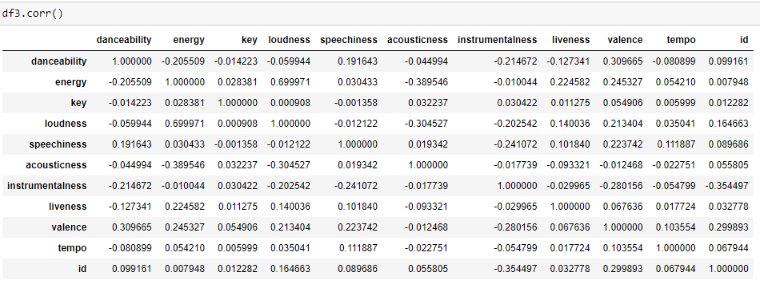
Data Analysis using Visualization:

Slide 14
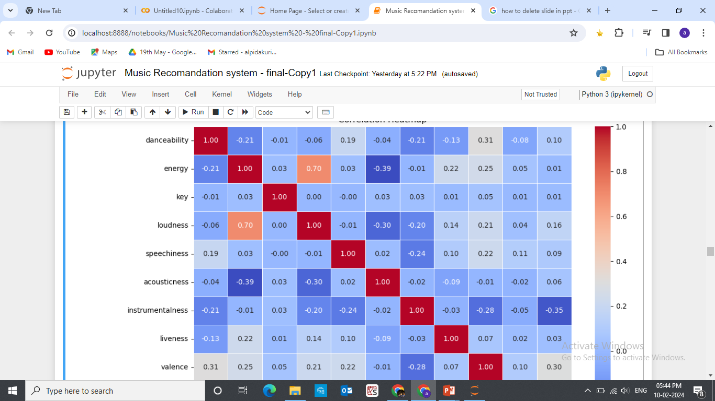
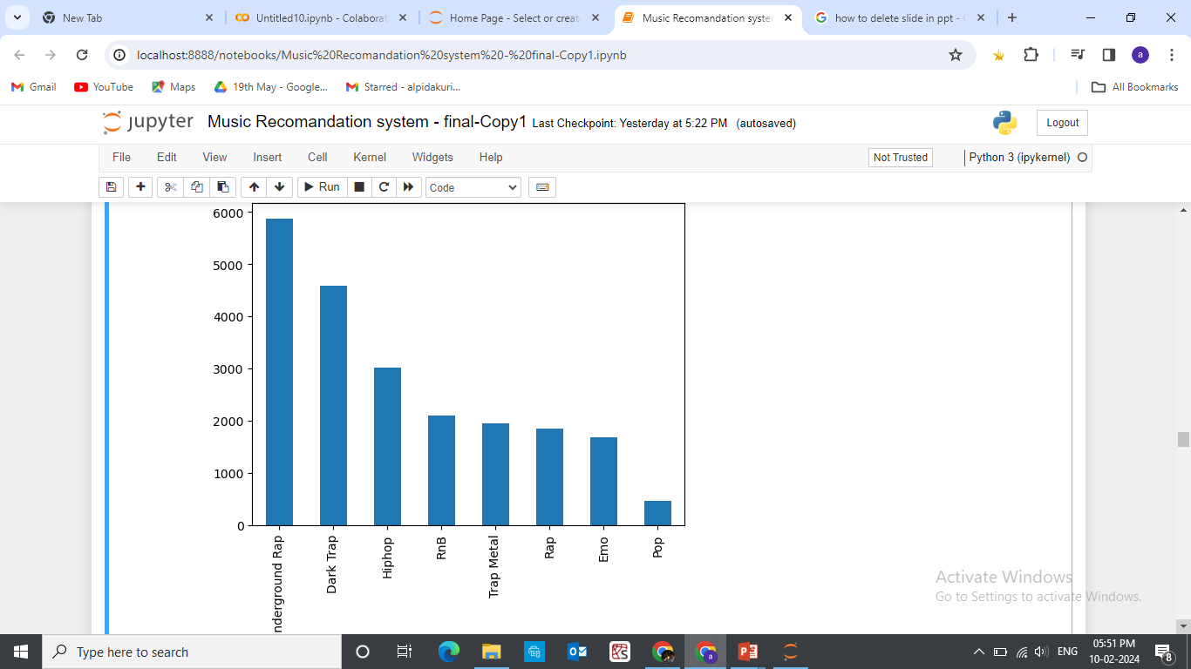
Heat Map:
Genre value counts:

Slide 15
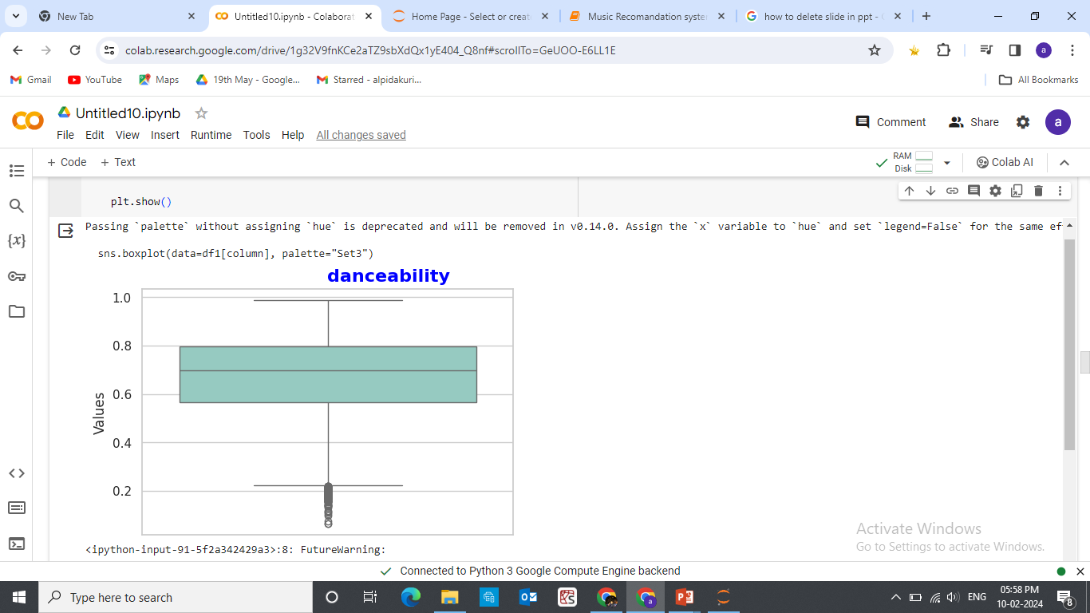
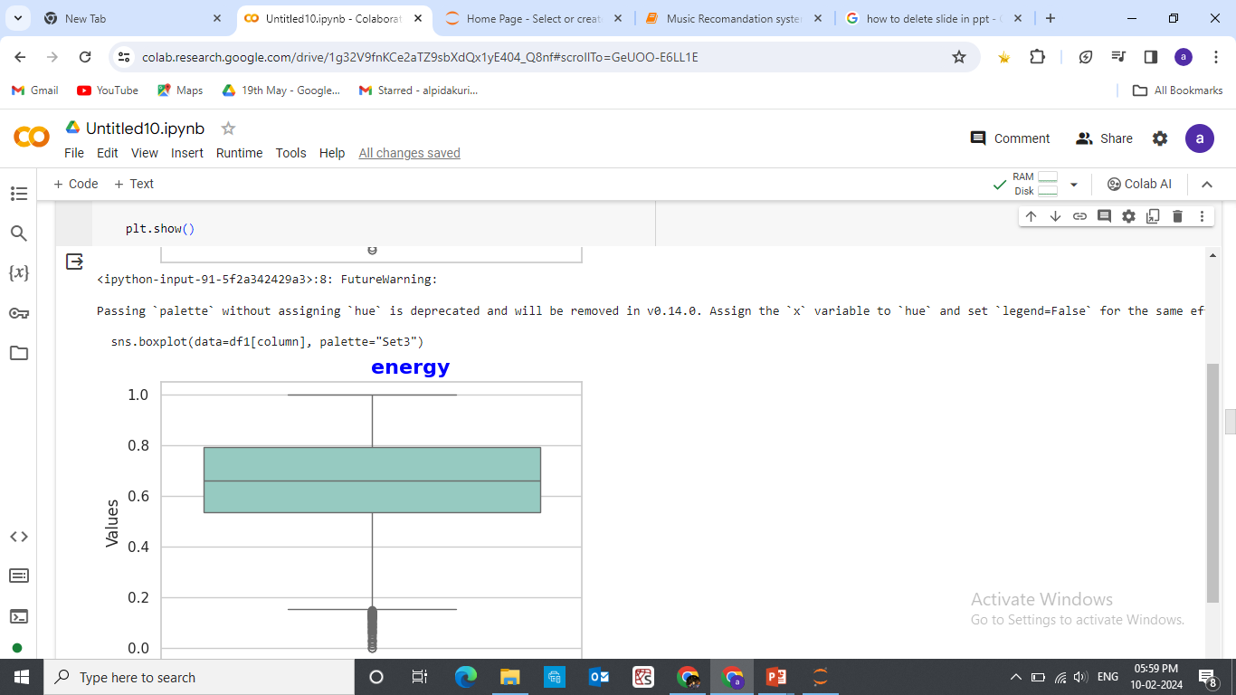
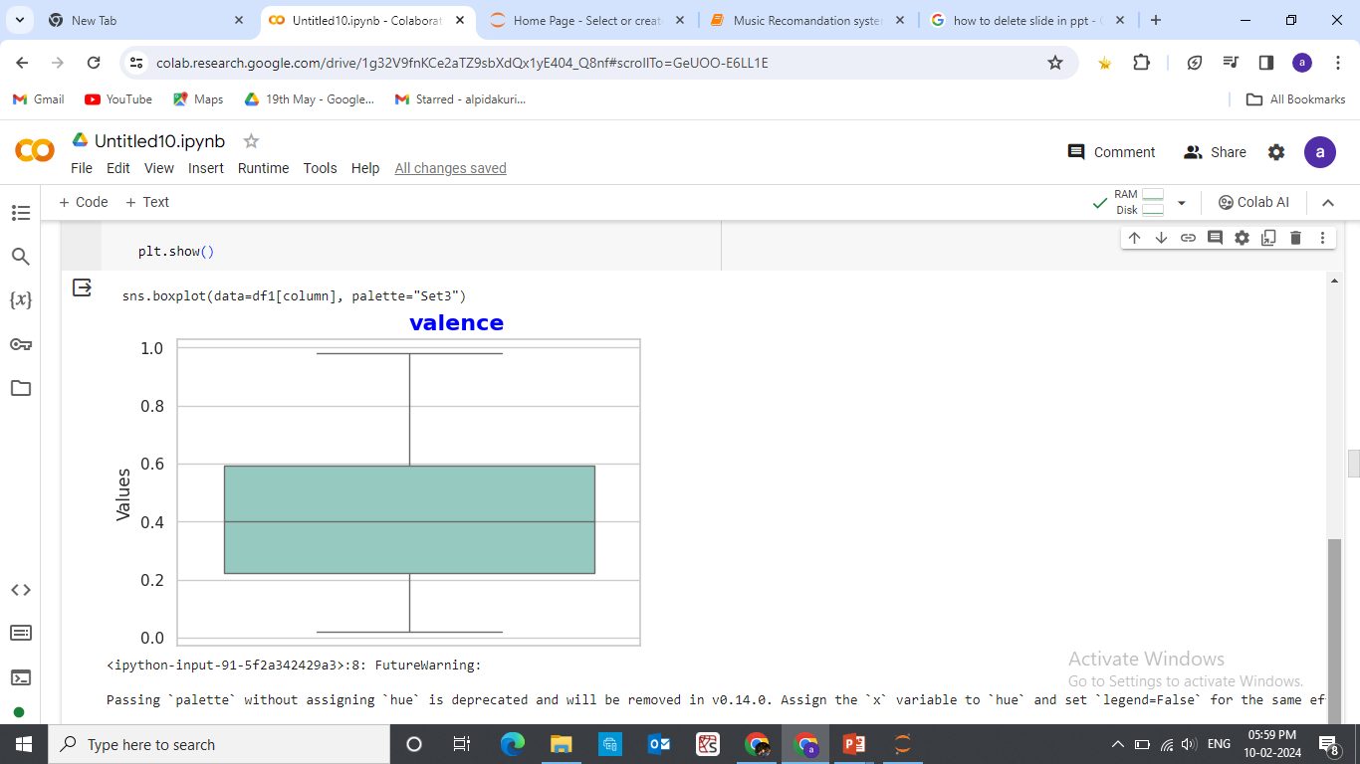
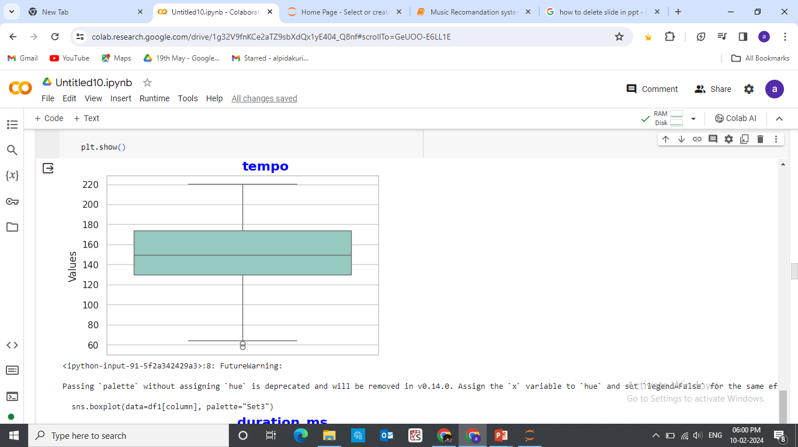
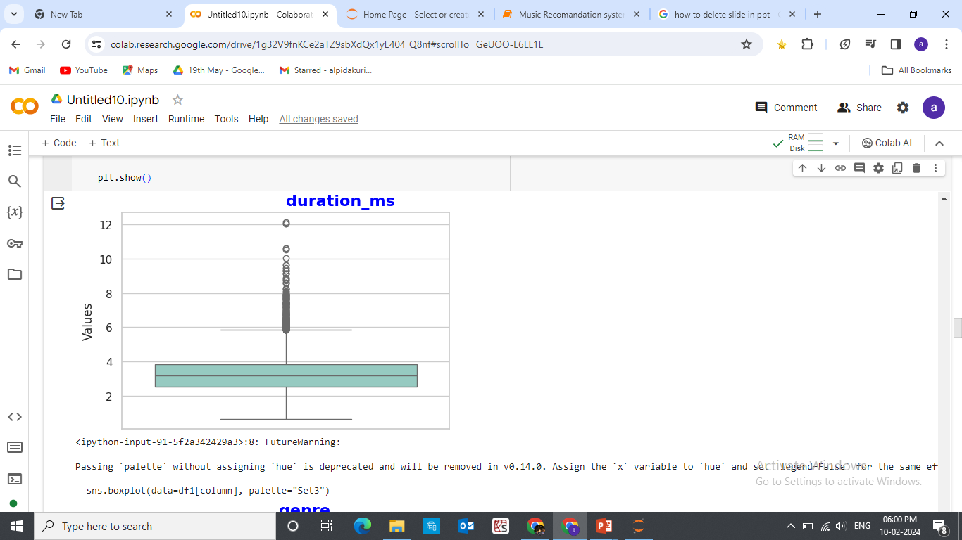
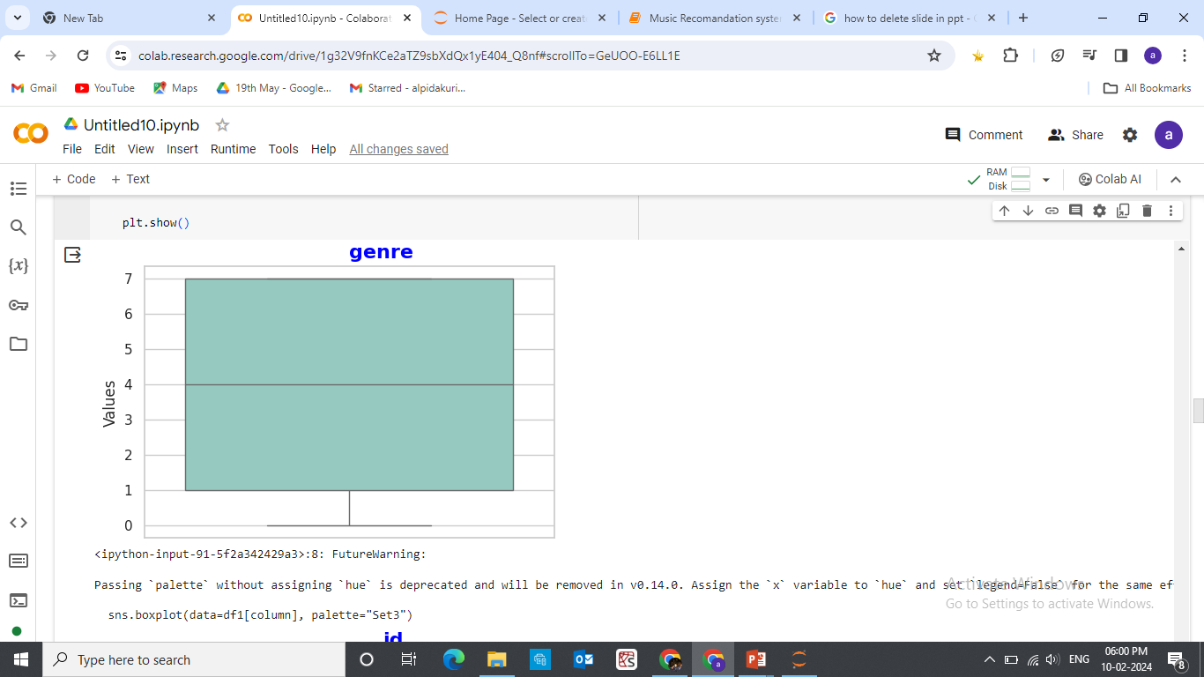
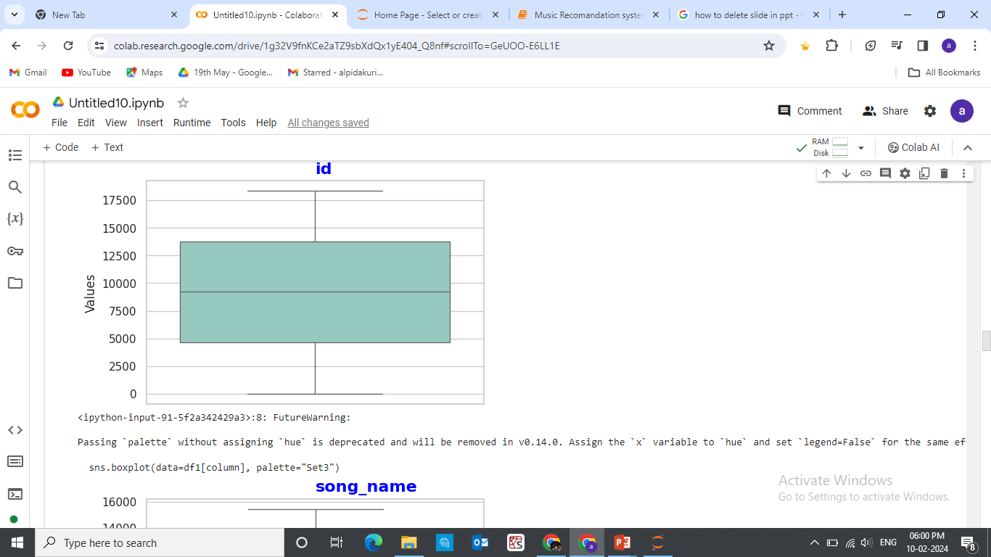
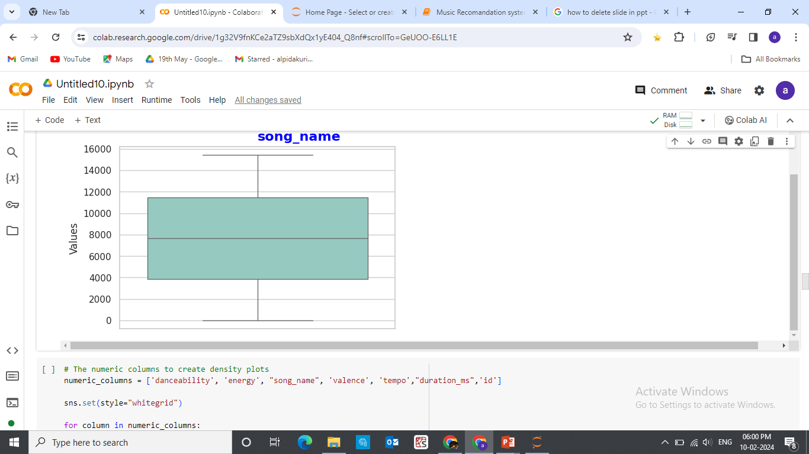
Boxplot for Visualization:

Slide 16
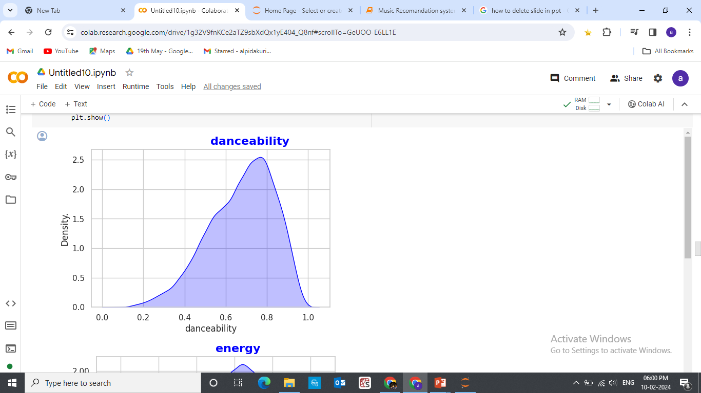
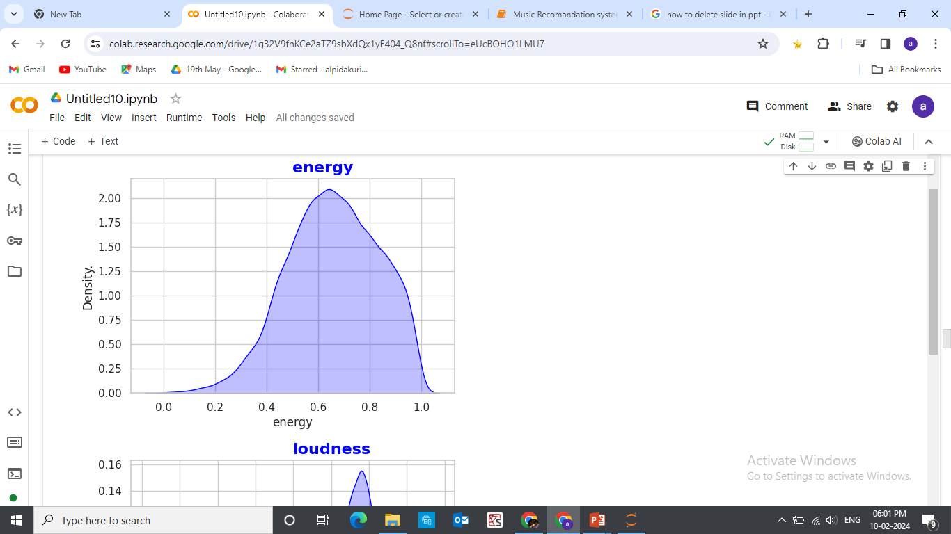
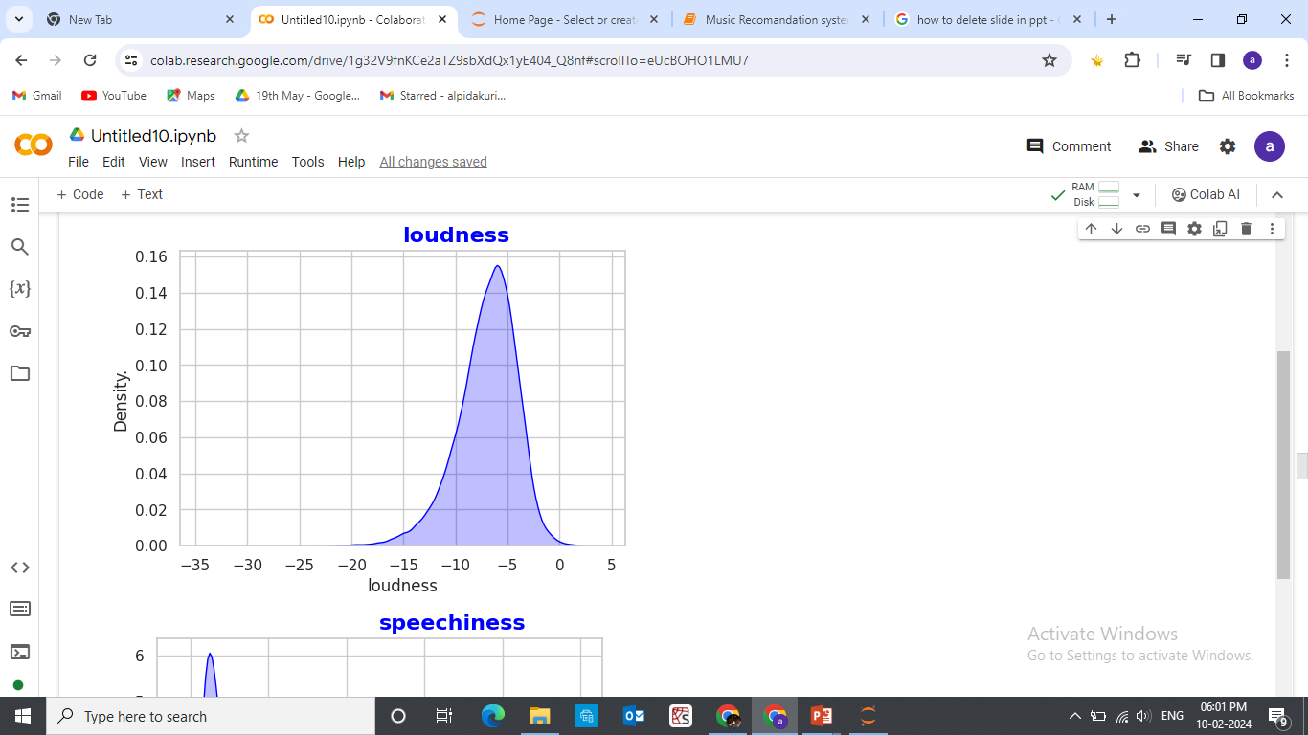
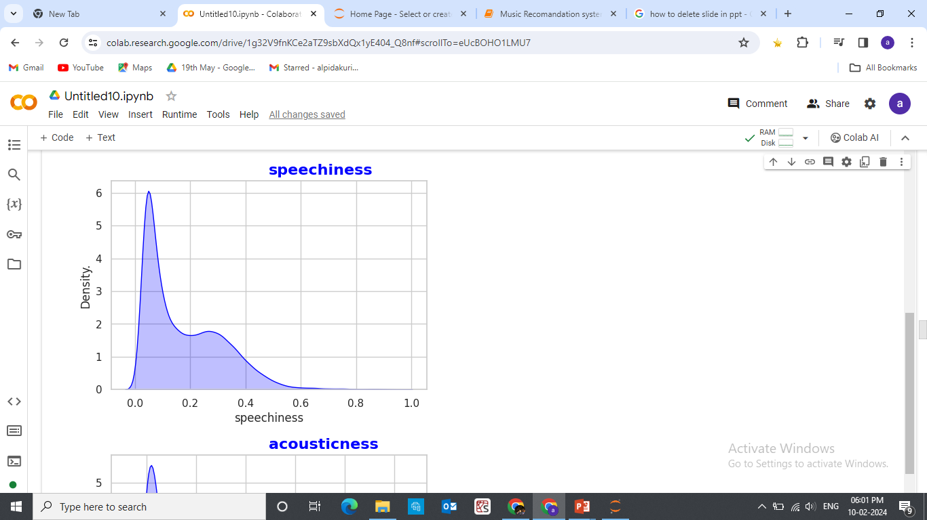
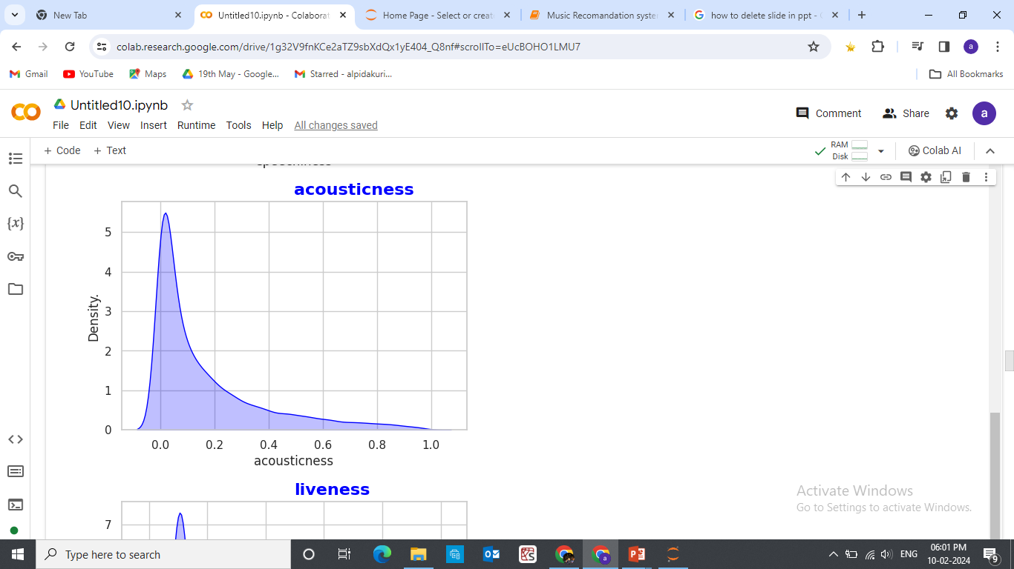
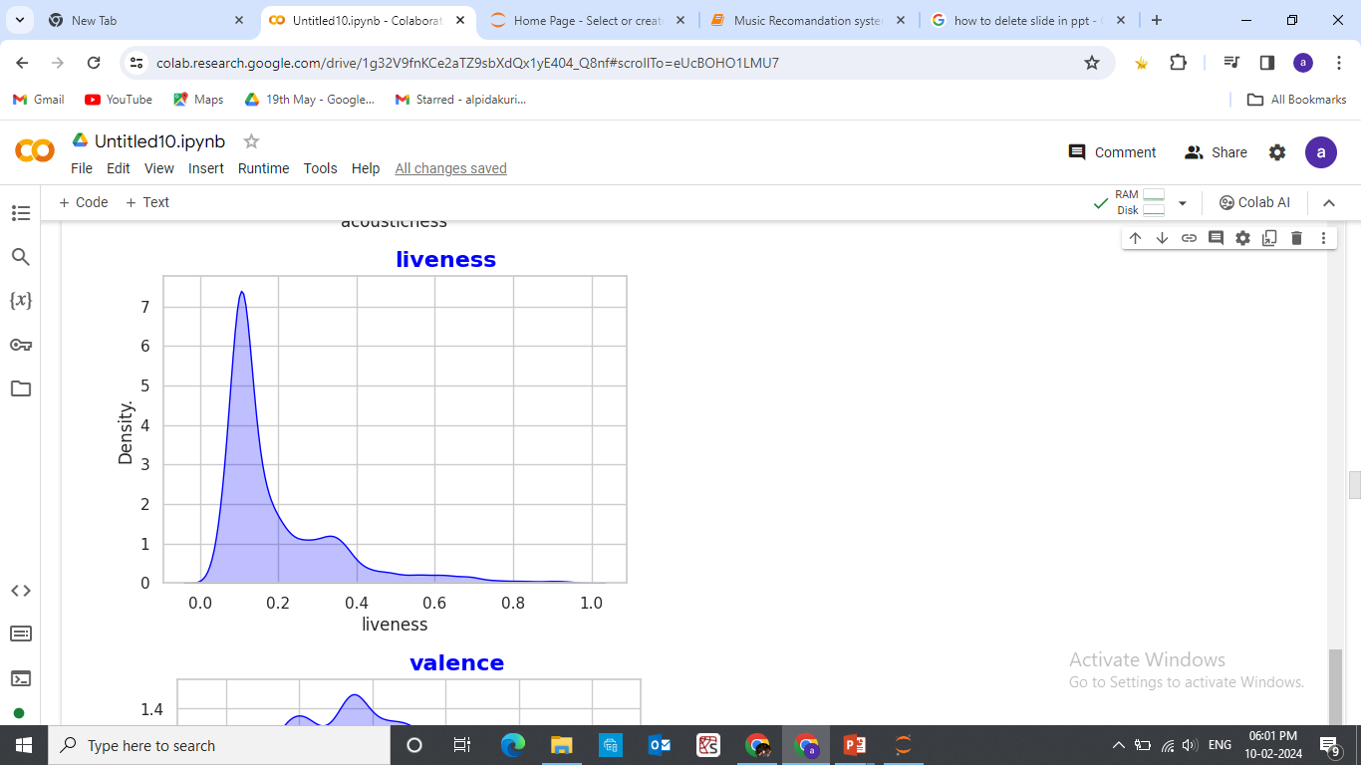
Density Visualization:

Slide 17
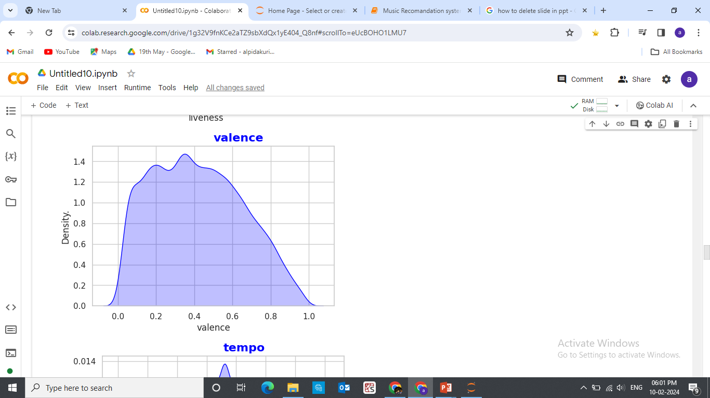
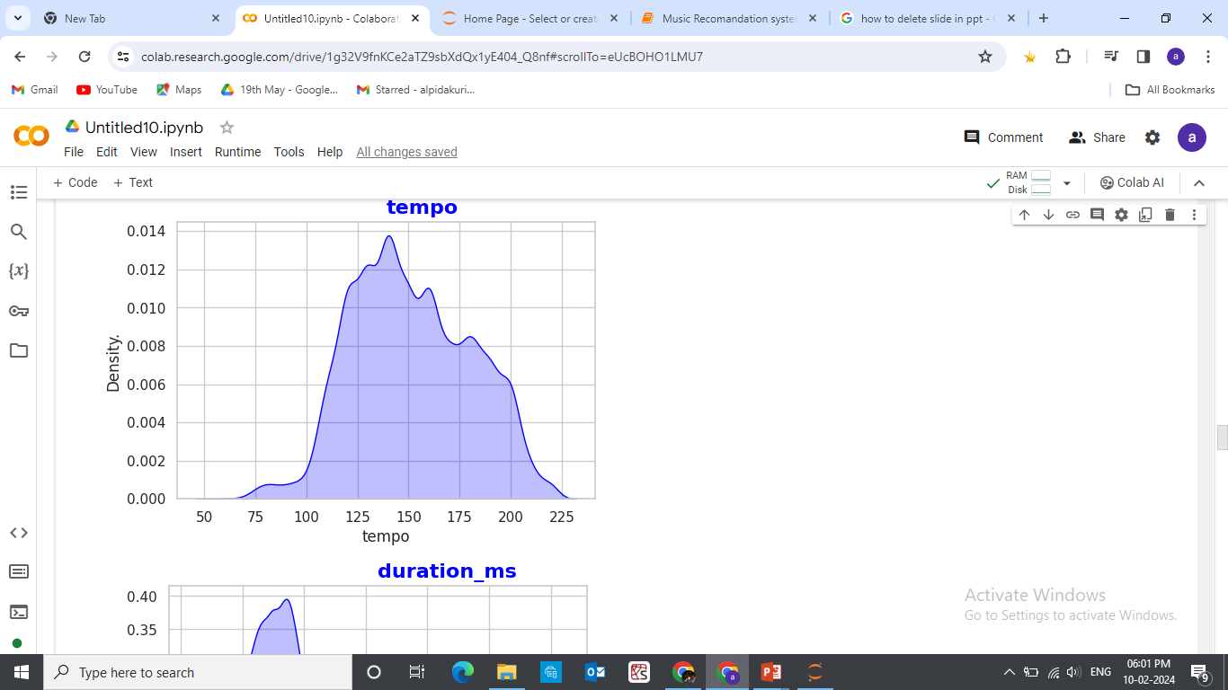
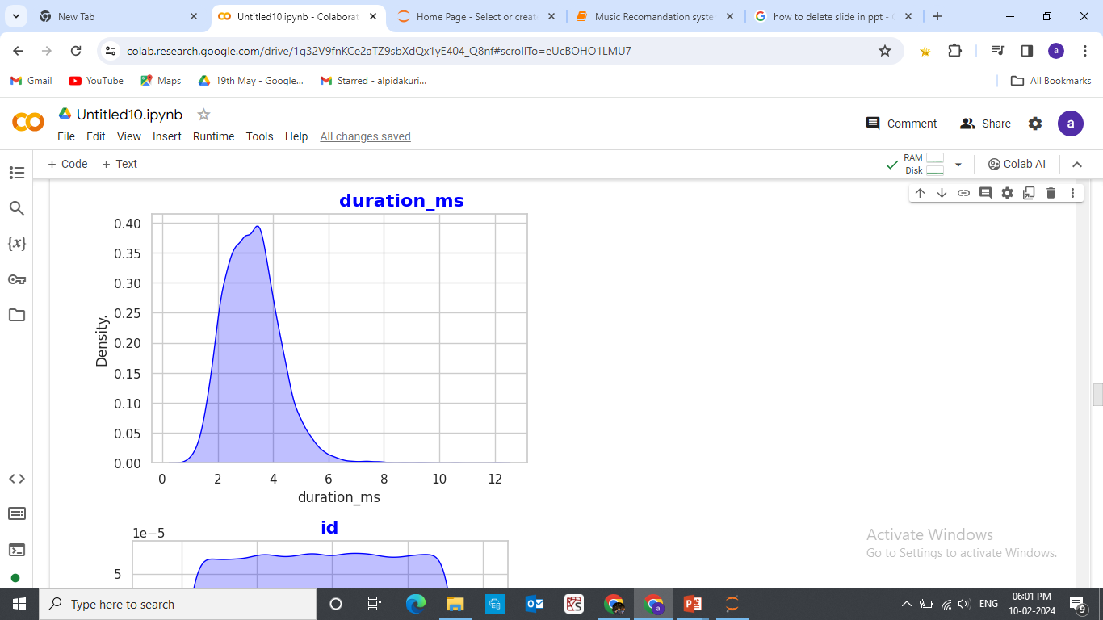
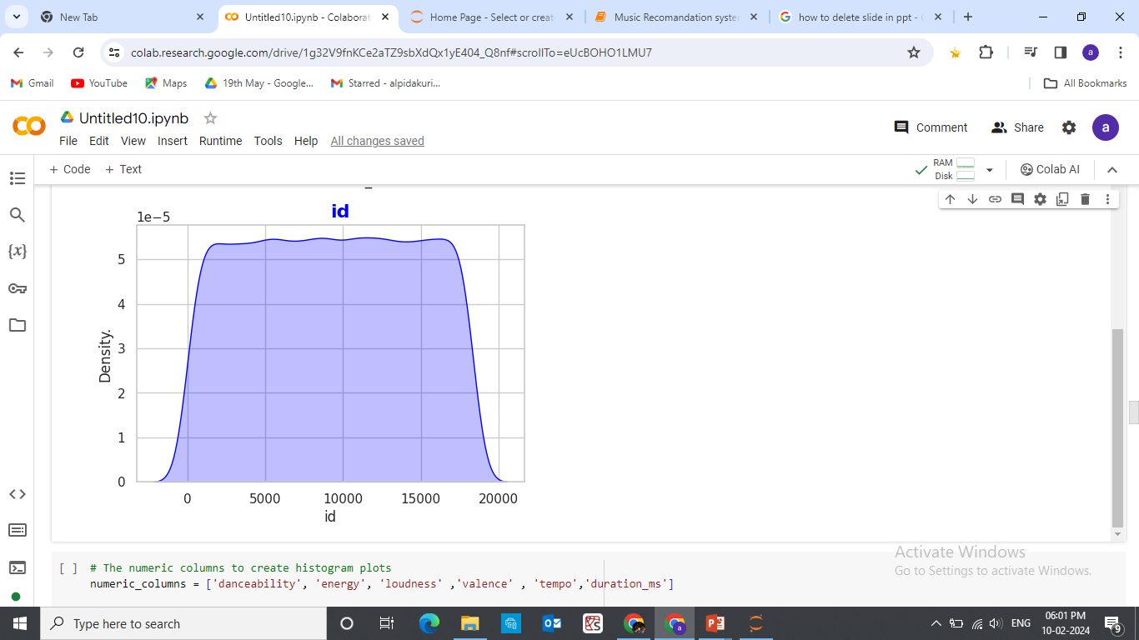

Slide 18
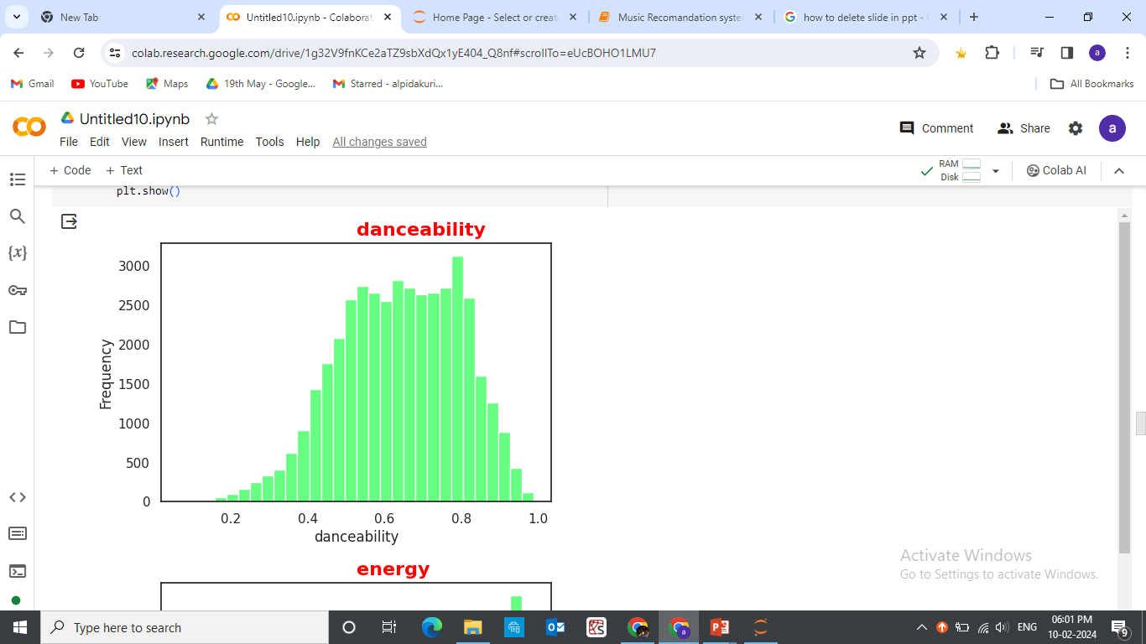
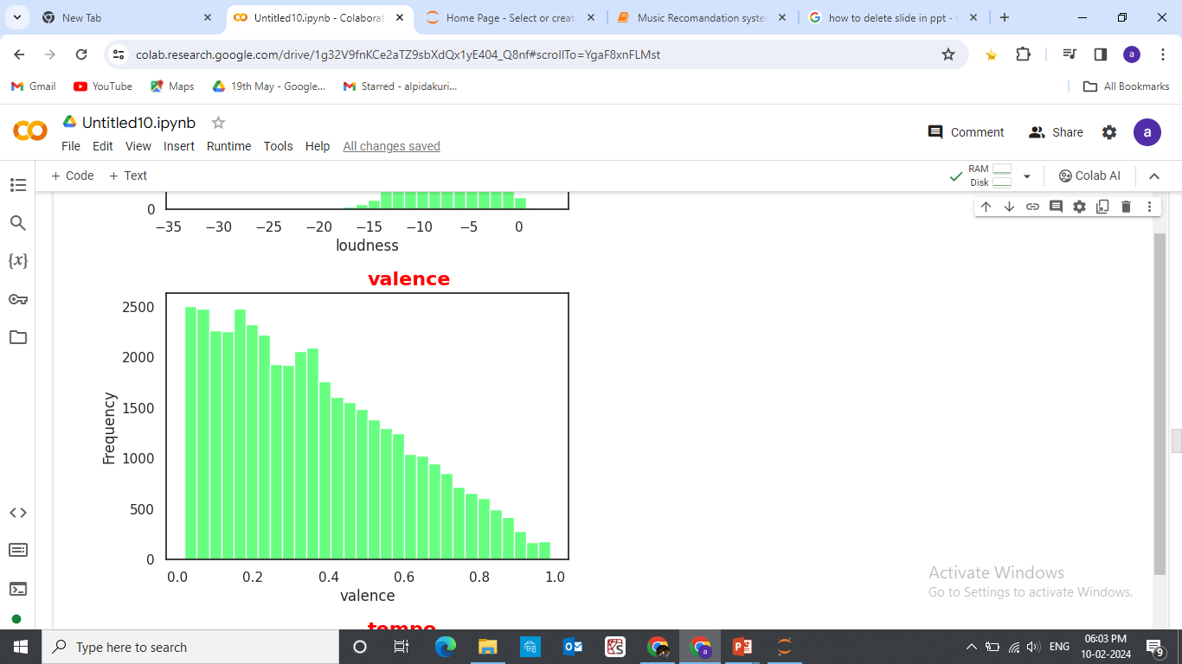
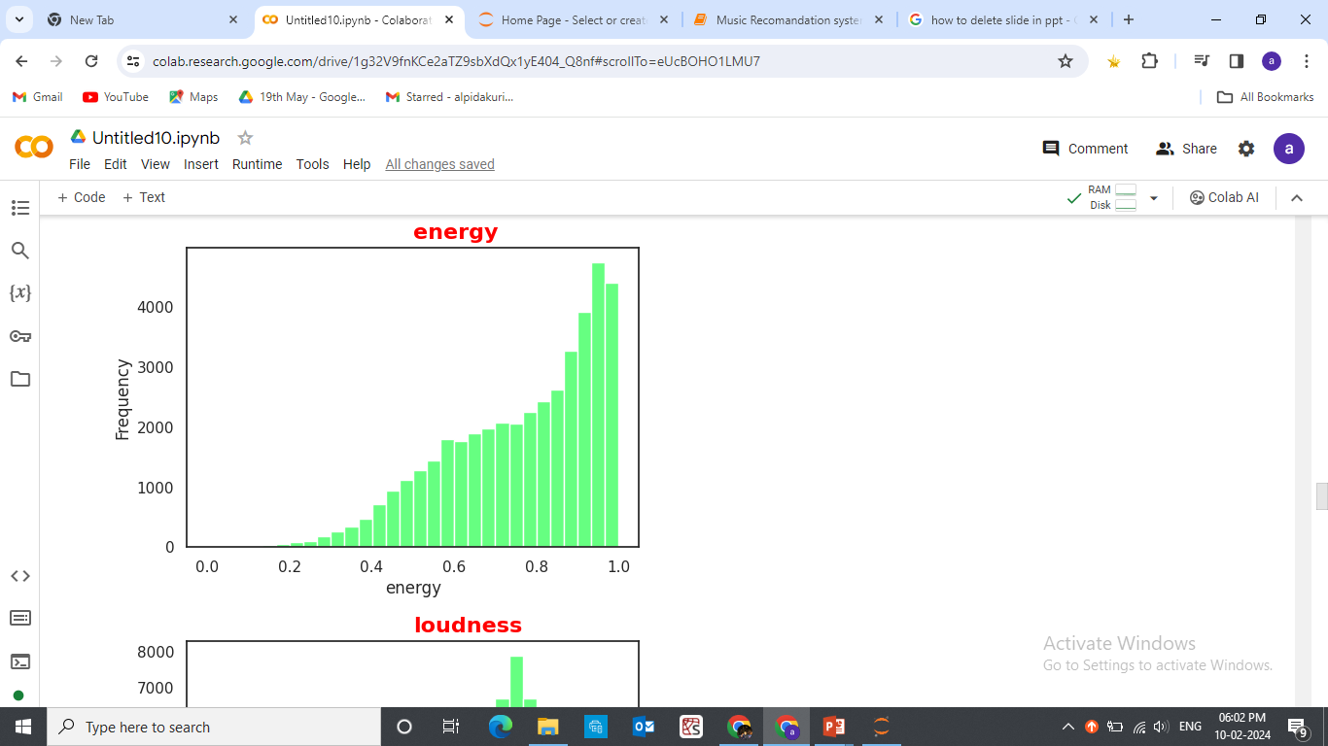
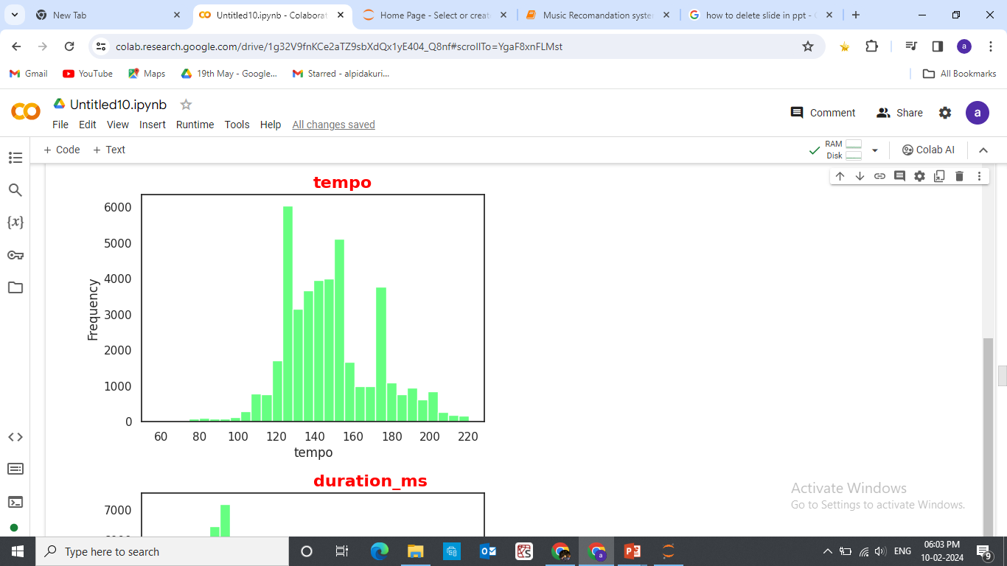
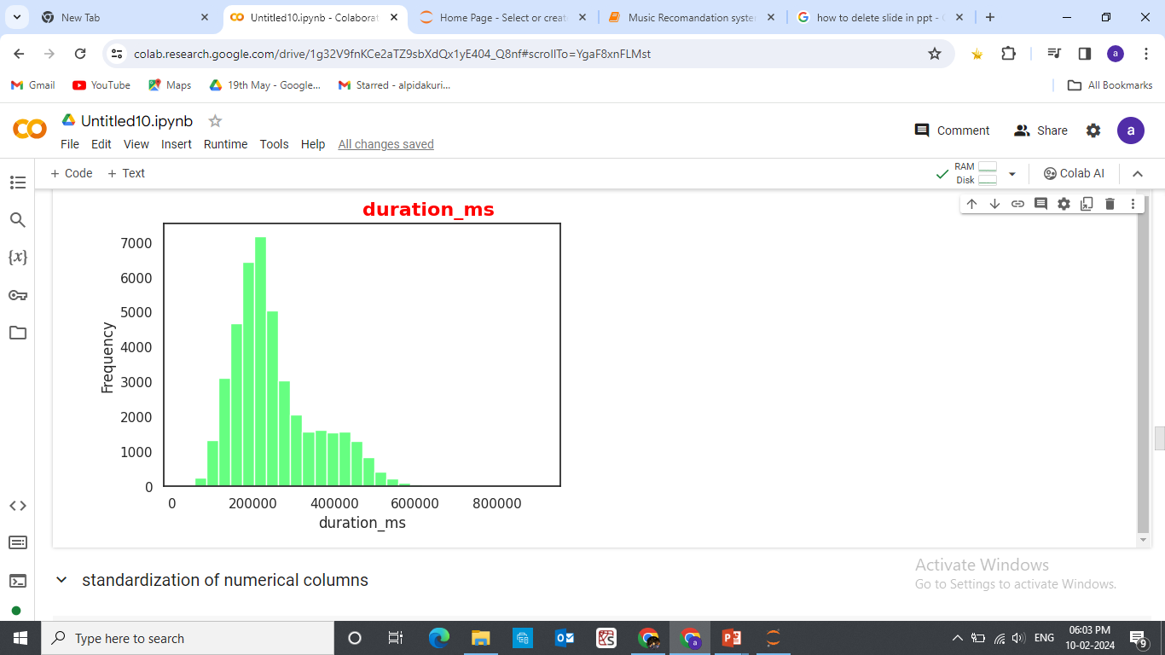
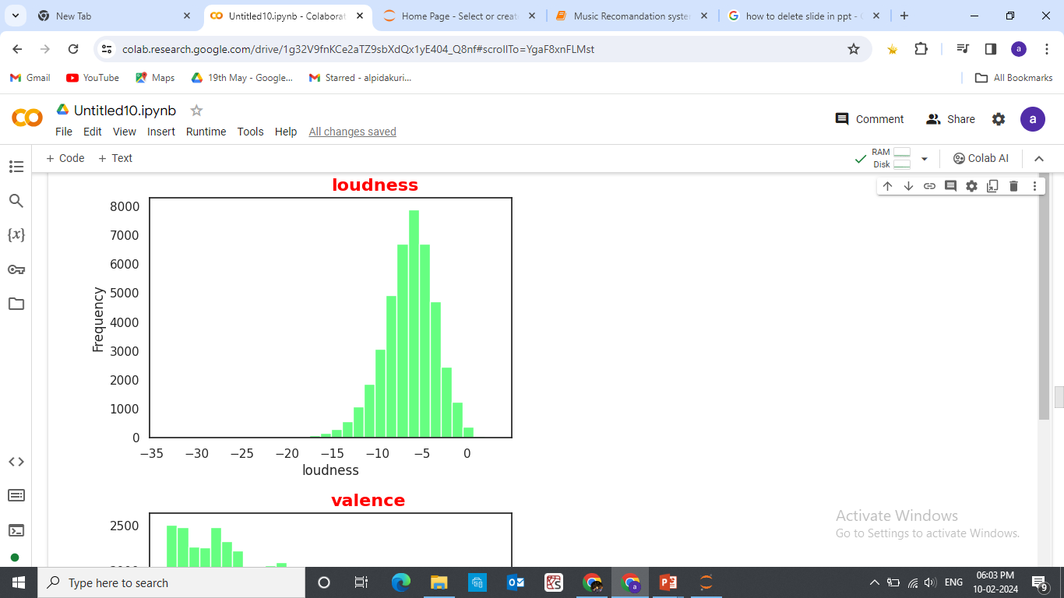
Histogram Visualization:

Slide 19
Model Building with Recommendation Algorithms:
1.Collaborative Filtering : By analyzing the listening patterns and preferences of similar users , the system recommends songs and artists
That align with your taste.
2.Content- Based Filtering : Based on the attributes of songs and artists you enjoy and artists you enjoy, the system suggests similar
Tracks and musicians that match your musical preferences.
3.Hybrid Approaches : Combining collaborative filtering and content based filtering techniques , hybrid algorithums offer Comprehensive and diverse music recommendations.

Slide 20
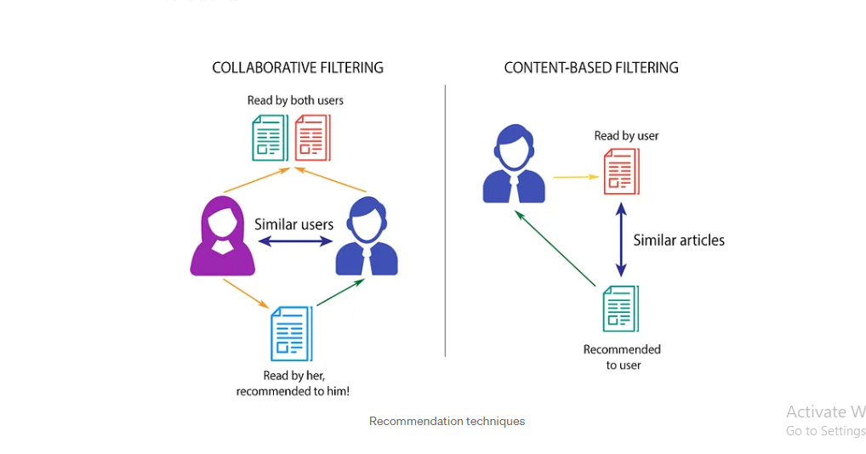
Types of Recommendation System:

Slide 21
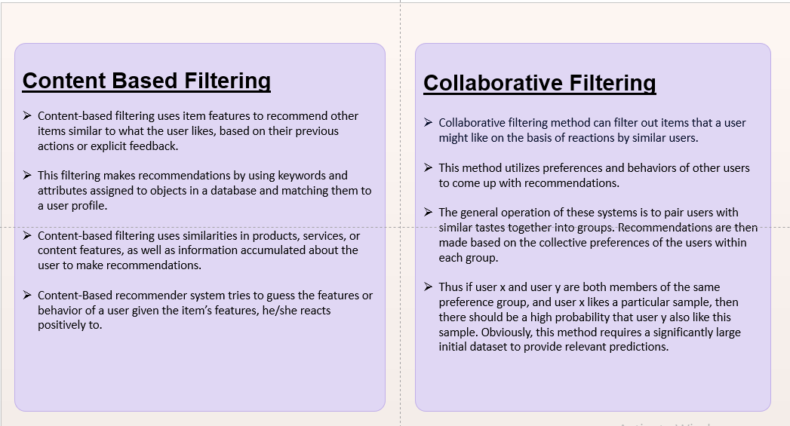

Slide 22
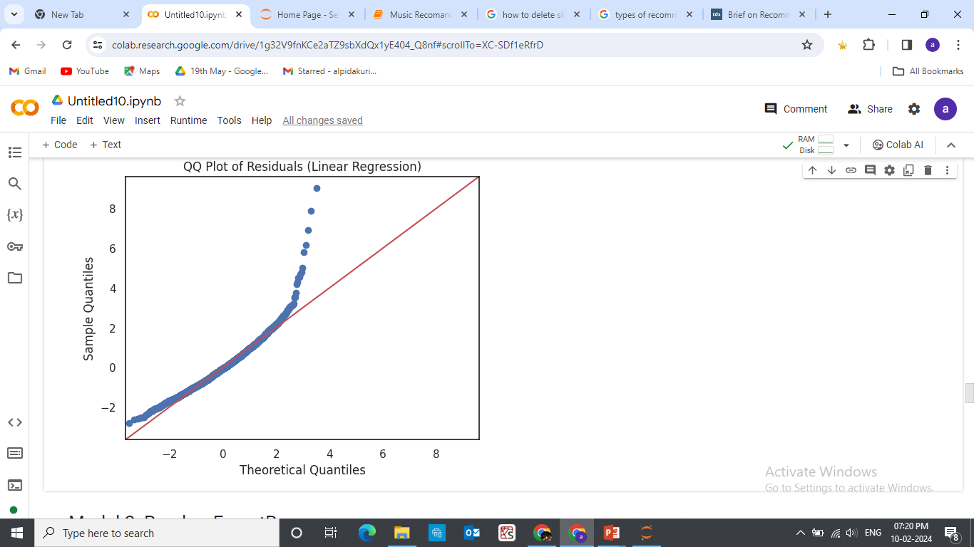
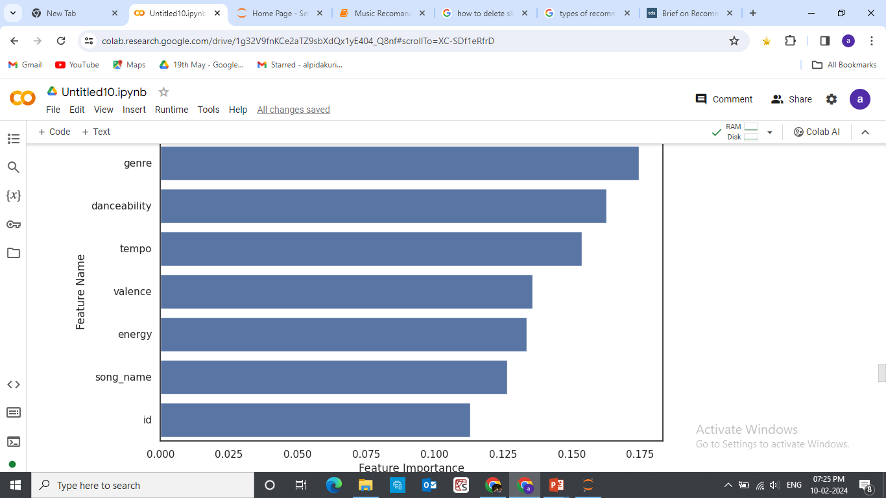
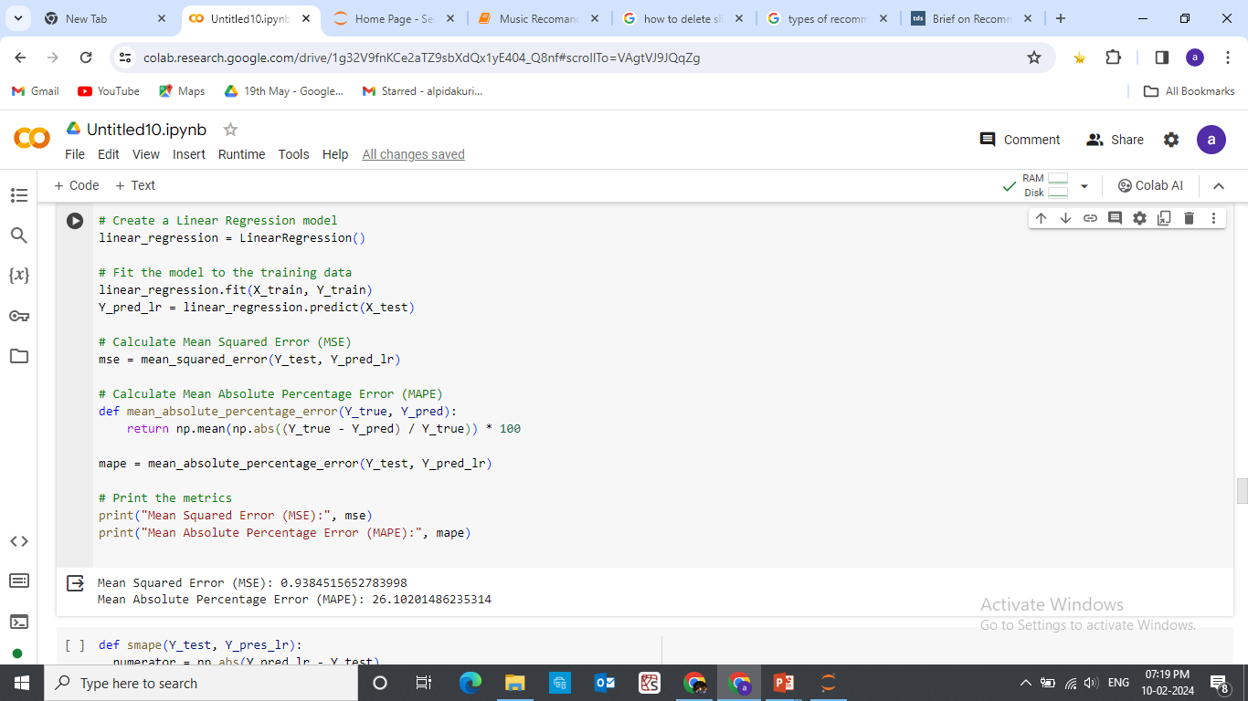
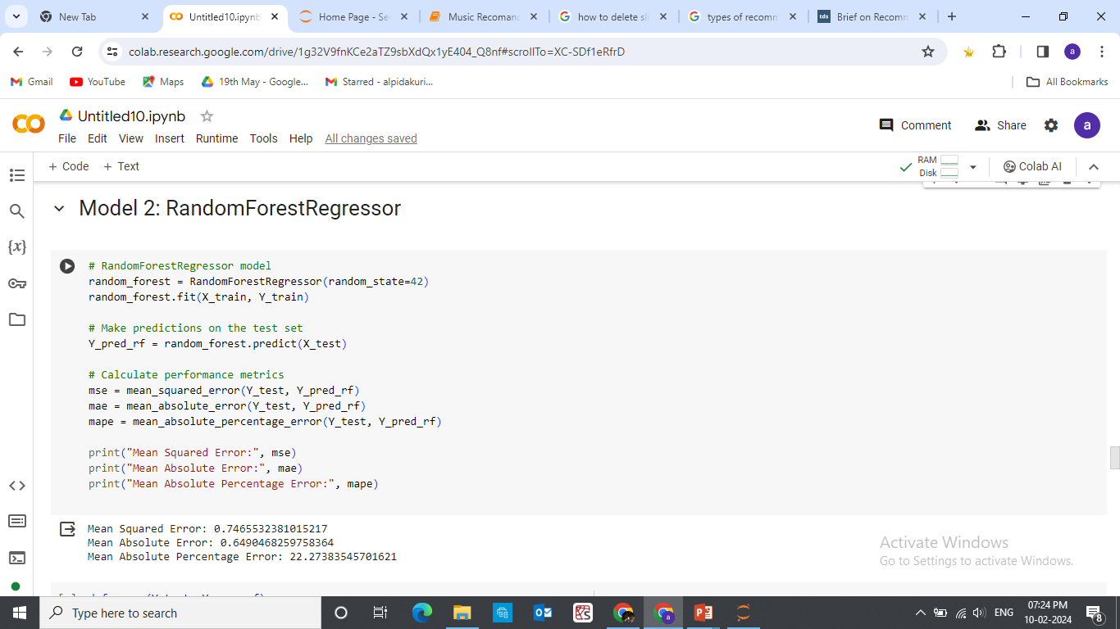
Overview of different models: Feature(x):Danceability,energy,valence,tempo,song_name,genre,id Target(y):Duration_ms
Linear Regression:
Random Forest Regressor:

Slide 23
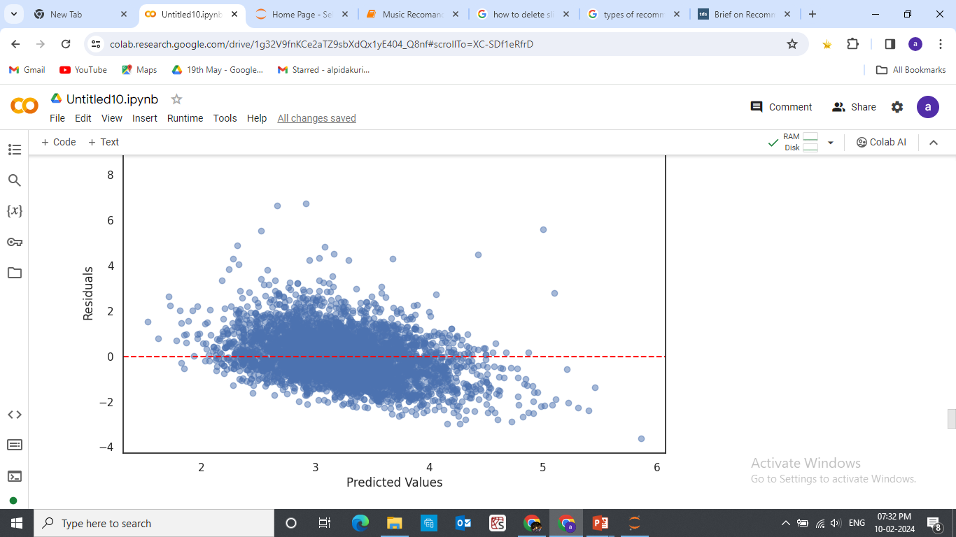
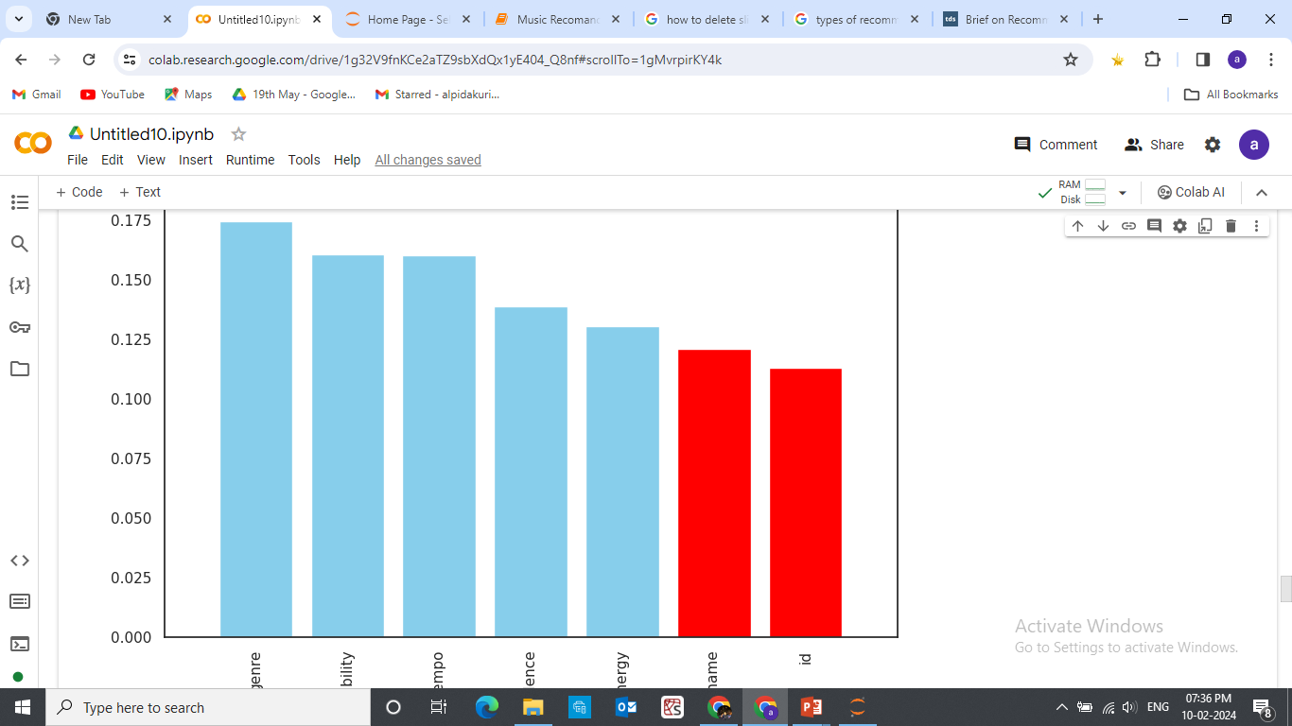
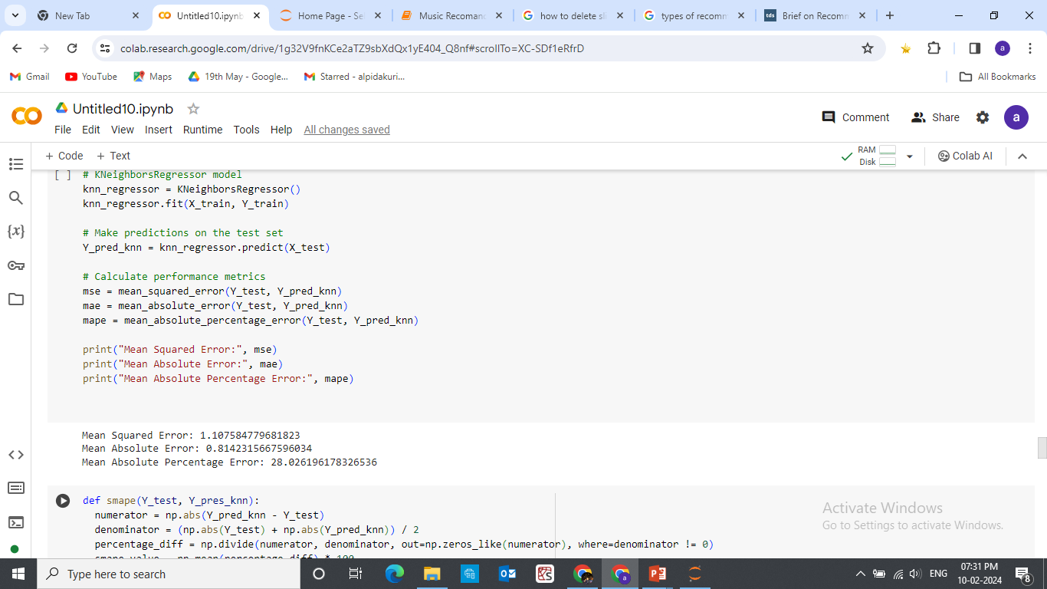
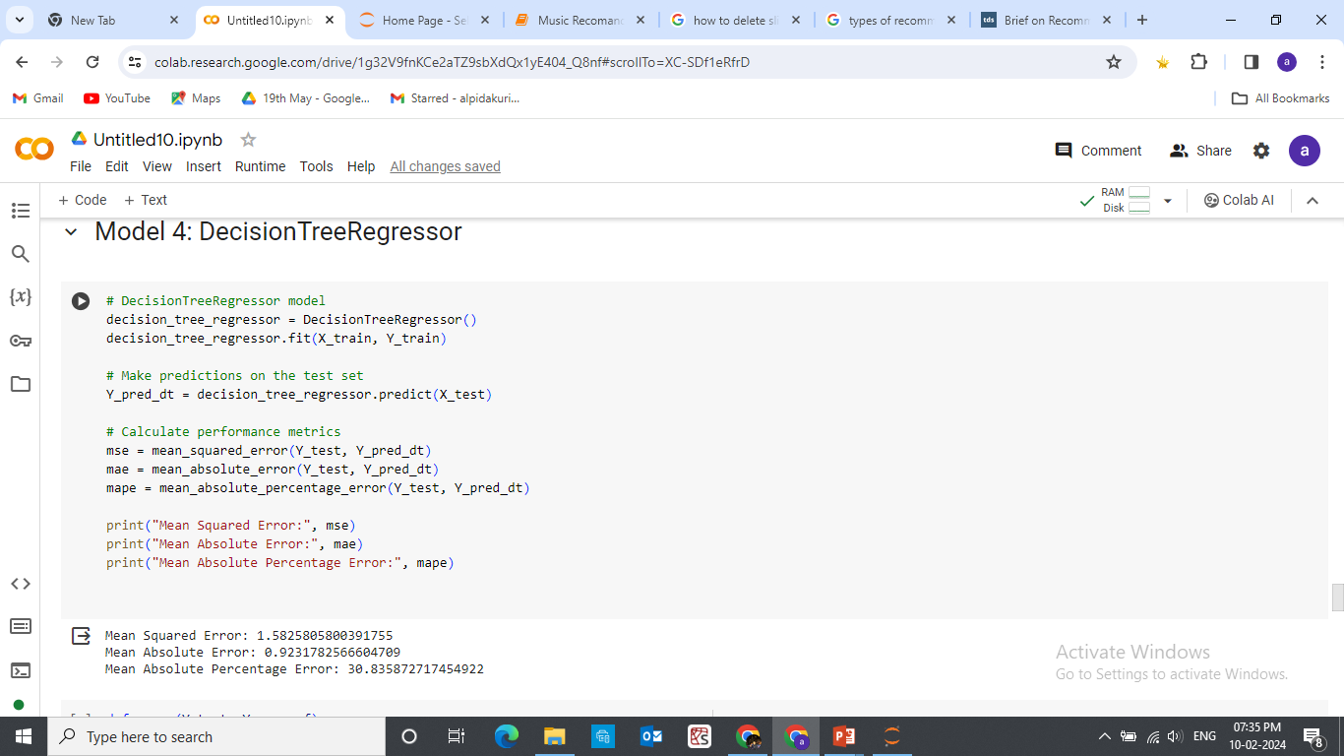
K-Neighbours Regressor:
Decision Tree Regressor:

Slide 24
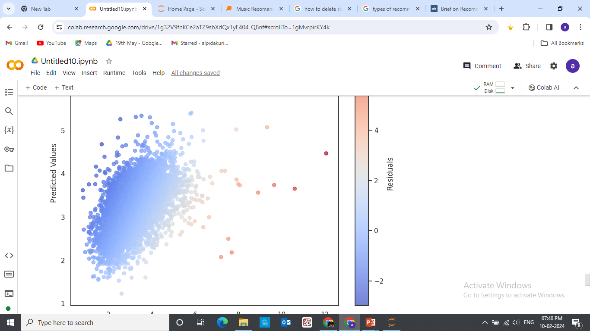
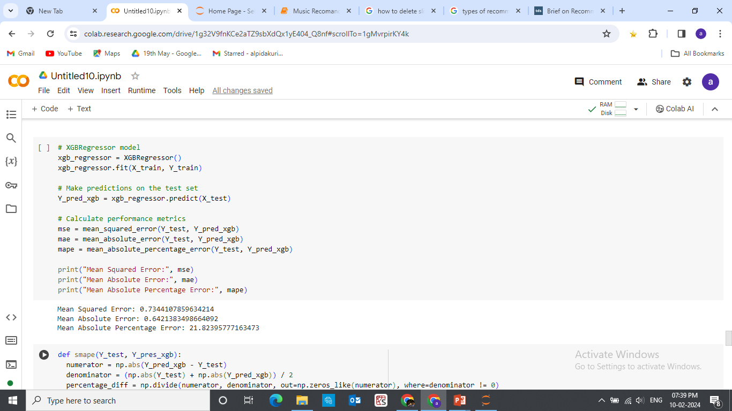
XBGRegressor:

Slide 25
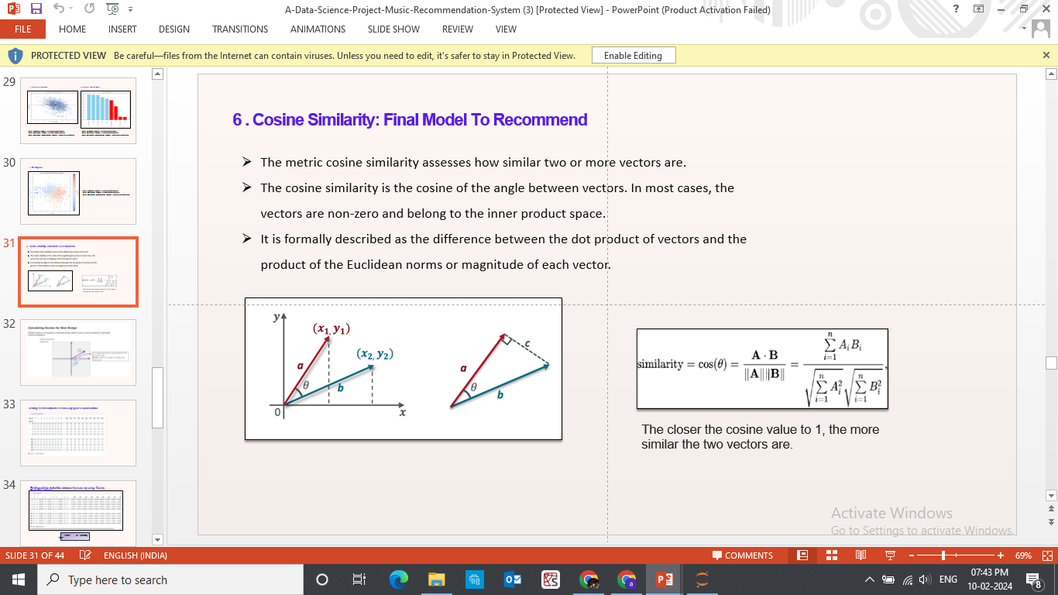

Slide 26
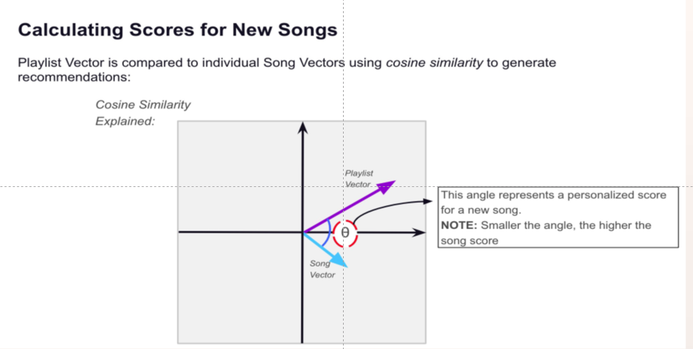

Slide 27
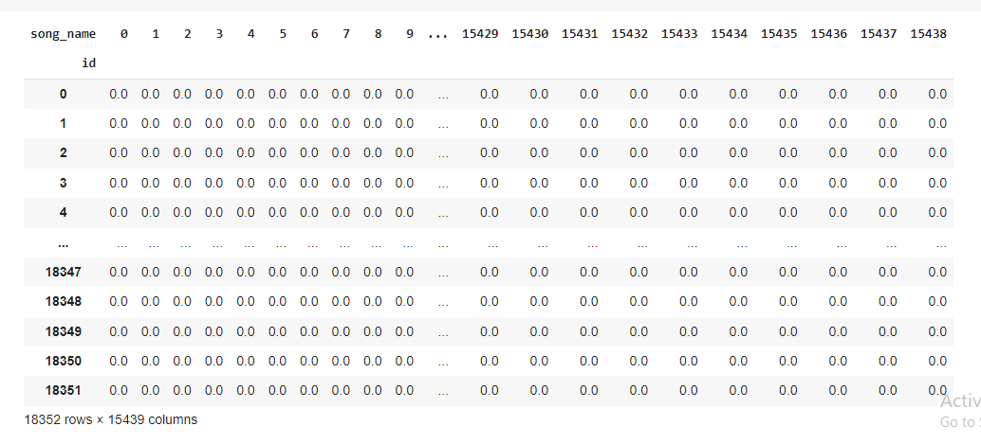
Creating User Item Matrix for user and Songs Genre Recommendation:

Slide 28
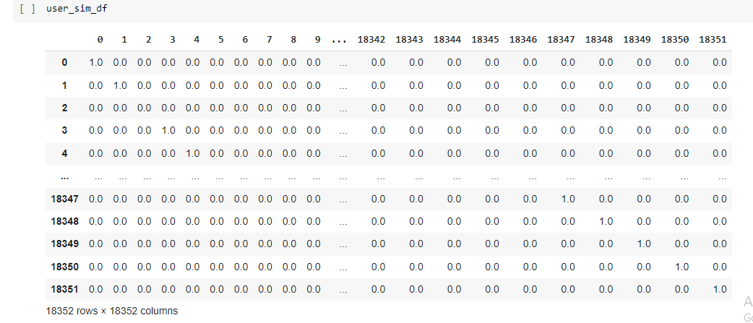
Finding out the similarities between the users by using cosine similarities matrix:

Slide 29
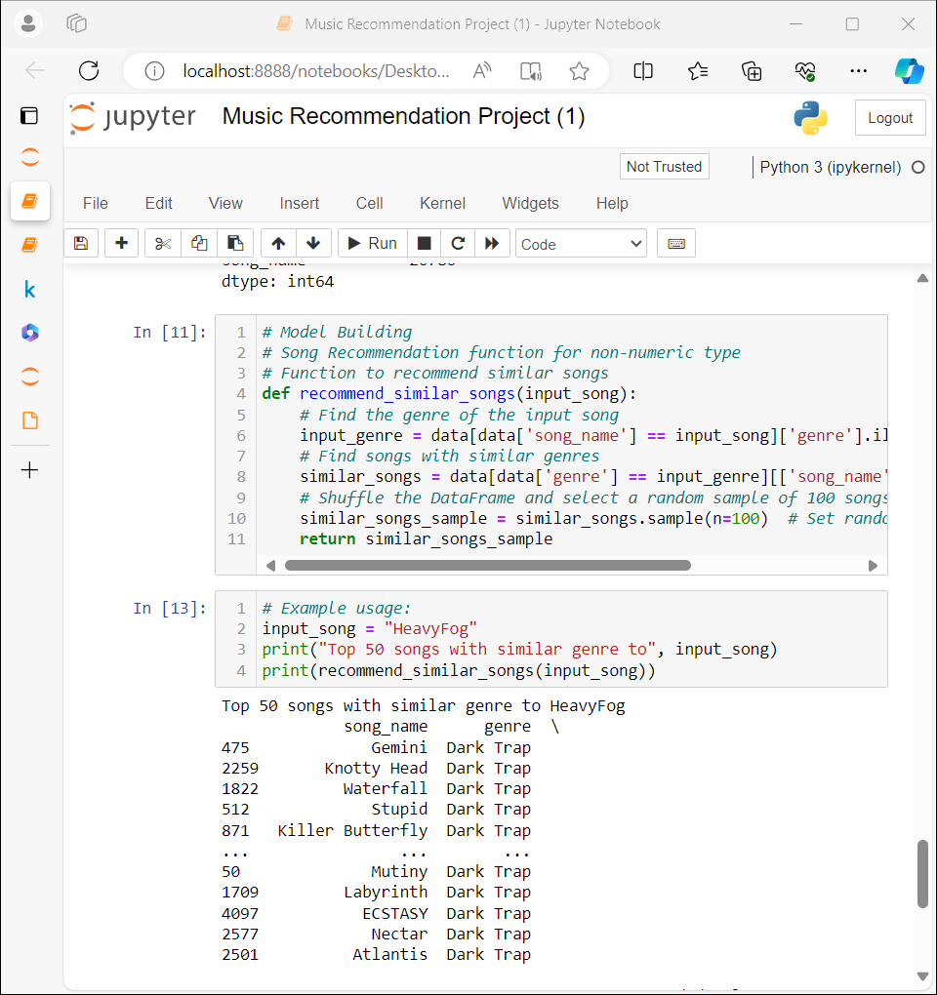
By Using Content Based Filtering:(Final Result)

Slide 30
Final Model Selection
As we could not find success in other methods including cosign similarity metrics we decided to go for content based filtering as a final model ..

Slide 31
Deploying the system
Selecting an appropriate deployment platform
Choose the ideal platform to deploy our music recommendation system for maximum accessibility.
Scaling the system for large user bases
Find out how we ensured the scalability of our system to cater to a growing user base.
Ensuring system stability and reliability
Learn about the measures taken to maintain the stability and reliability of the recommendation system

Slide 32
For deployment stream lit is used for following reasons…
It requires few line of code to build an app
Dose not require any web development knowledge
Deploy the code immediately and see the changes immediately by saving the sourse code…
Its an open source framework

Slide 33


Slide 34


Slide 35

Final output of User Interface

Slide 36


Slide 37
Learnings and conclusion …
The project was a great learning opportunity to learn unsupervised machine learning …As Music recommendation system is widely used in todays entertainment world …This project provided us a great platform to learn the same.
This recommendation engine make your platform maximum personalized. It automate curating and playlisting audio.
This system provide quality and immersive customer streaming experience and also get insights about users’ behavior and make data-based marketing decisions.
We were unable to create a model utilizing singular value decomposition and support vector machines due to a lack of time.
Also, there is a lot of potential in combining several dimensions in this music recommender systems. We will try to work on the same in the near future.
.

Slide 38
THANK YOU

